Slide 1
CHILD CARE
HEALTH & SANITATION
Robin Carns - EHS II
Child Care Program Coordinator
Mesa County Health Department
http://www.health.mesacounty.us/environment/childcare.cfm

Slide 2

Food Service
Hand Washing
Infant/Toddler Nurseries
Interior Design
Cleaning and Disinfecting
Toxic Items
General Facility
Disease Prevention
Understanding the Basics

Slide 3
FOOD SERVICE REQUIREMENTS
Facilities Providing Meals/Snacks Shall Meet Requirements of Colorado Retail Food Establishment Rules and Regulations
Key Exceptions:
1. Limited grease cooking - no commercial hoods required.
2. Domestic equipment allowed when:
a. Specialized group/residential facilities, camps, 15 or fewer
children, or
b. Infant nurseries, toddler nurseries, kindergartens, or
c. Operated less than 4 hrs/day, or
d. Other facilities where menu is simple.

Slide 4
Food Service Options
Snacks Only
Limited Kitchen
Commercial Kitchen
Individual meals furnished by parents restricted to their own child and labeled
Shared snacks furnished by parents must be shelf stable, prepackaged and from a commercial source

Slide 5
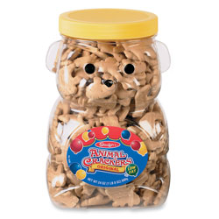
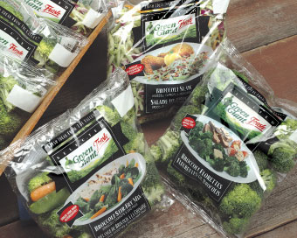

SNACKS
Must be pre-packaged/commercially prepared
Must be pre-washed/pre-cut
No utensils to wash, rinse, sanitize
Approved sources

Slide 6
Limited Kitchen requirements
Only packaged, shelf stable snacks
From approved sources
Protected during transport, storage, preparation and
service
Good hygienic practices
No bare hand contact (utensils, gloves)
Hand washing
Served with single use articles or utensils that are washed,
rinsed, and sanitized
Produce washed in a sink approved by Health Department
(not a hand sink), or purchased pre-washed/pre-cut

Slide 7
COMMERCIAL EQUIPMENT REQUIRED IF:
The facility’s menu involves advanced food preparation*.
The local building or fire department requires a hood.
Leftover potentially hazardous foods are cooled for re-service.
Prepared food is transported off premises for service or consumption at another facility.
Domestic equipment cannot maintain potentially hazardous foods at the required temperature.
*Advanced Food Prep –Cooking or assembling potentially hazardous food more than 4 hours in advance of service.

Slide 8
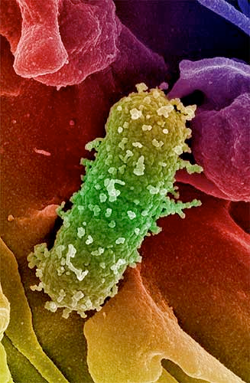
WHY ARE THERE FOOD TEMPERATURE REQUIREMENTs?
Bacteria which is capable of causing food borne illness, is
present everywhere.
Bacteria need moisture, food, time, and the right temperature
conditions to grow (41ºF to 135ºF). After 4 hours in
the temperature danger zone, food must be discarded.
Assure temperatures are maintained by
taking temperatures with a calibrated food
thermometer.
Assure temperatures of equipment are maintained
by having a thermometer in the refrigerator and
maintaining temperature logs.

Slide 9
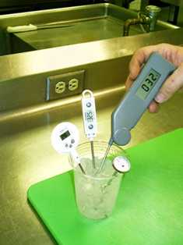
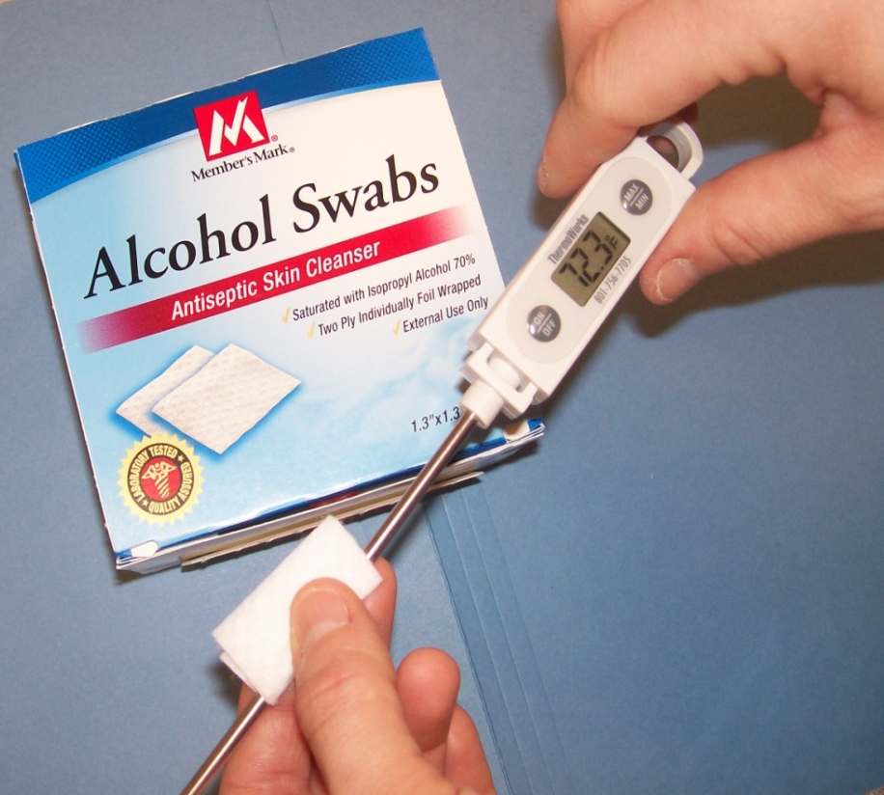
TAKING FOOD TEMPERATURES
Is it accurate? If not, calibrate in slushy ice mixture
Sanitize Your Thermometer Between Uses

Slide 10

Cold Holding
Potentially Hazardous Foods
41°F or below
Keep an accurate thermometer in your refrigerator
Refrigeration is not a kill step.
It only slows bacterial growth.
Notes:
The first temperature you need to know for the test is the cold holding temp of 41°F or less.
The only way to know for sure the temperature of the food is USE A THERMOMETER. We encourage you to log you temperatures.
Cold food must be held at 41°F or less whether it is in the walk-in, on the salad bar or stored in the make table.
Store cold food 41°F or less to prevent bacterial growth.
Refrigeration does not kill bacteria…it only slows bacterial growth!!
It maintains the bacterial load low enough so someone does not become ill. Refrigeration does not eliminate bacteria and viruses therefore handling the food is still of great concern, especially cooking which can kill bacteria that may be present.

Slide 11
Hot Holding
135°F or above
If foods drop below 135ºF they must be reheated to 165ºF within 2 hours.
Notes:
The second temperature you need to know for the test is the 135°F hot hold temperature. Whether the food is stored in a holding unit, in a steam table or under a heat lamp, the minimum hot hold is 135°F.
In order to keep bacterial growth to a minimum all hot foods being held hot need to be held at 135°F or higher.
Monitoring hot holding temperatures every 2-3 hours and documenting internal food temperatures on a temperature log ensures that potentially hazardous foods have not been maintained in the temperature danger zone. By monitoring hot holding temperatures, steam tables and hot holding equipment can be adjusted and set to the appropriate temperature.

Slide 12
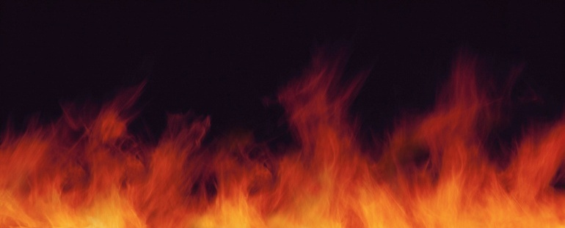


Cook step = Kill step
Pork, Eggs, Fish, Lamb 145ºF
Ground beef 155ºF
Poultry, Stuffed meats & pastas 165ºF
*Reheating foods to 165ºF must be done within two hours
Heat from cooking kills bacteria
Notes:
Cook step is the only way to kill bacteria when preparing foods.
Knowing each foods final cook temperature is essential to safe food handling.
Temperatures are also important to know when storing raw meats.
Raw meats with lower cook temperatures are to be stored above raw meats with higher cook temperatures to insure if there is any contamination that the meat below will reach the cook temperature of the meat that has contaminated it.
COOKING/HEAT IS THE ONLY WAY TO KILL BACTERIA!!!
What should the internal temperature of a stuffed pork chop be? I usually pick up the thermometer, pretend to use an alcohol swab and then stress that the probe goes into the stuffing, not the meat.

Slide 13
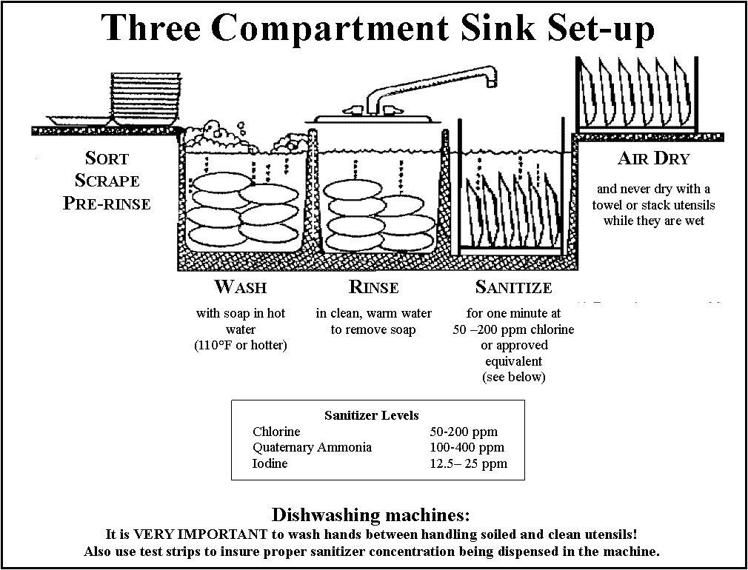

CLEANING UTENSILS AND SURFACES
Three Sink Method
  Pre-scrape or soak
  Wash in hot soapy water
  Rinse in clear hot water
  Sanitize 1 minute with approved sanitizer (bleach/quaternary ammonia)
  Air dry

Slide 14
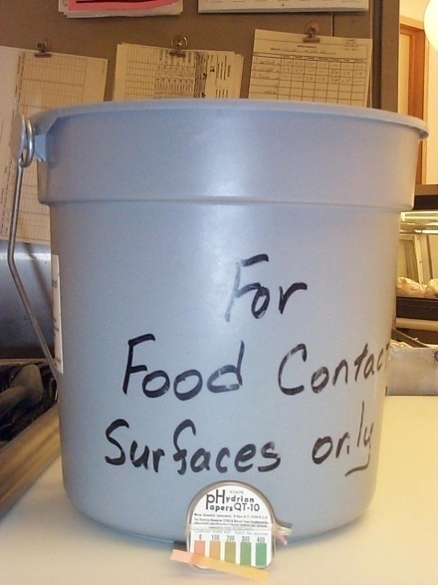
CLEANING UTENSILS AND SURFACES
Dish Machines
  50 ppm chlorine, or
  Water >155°F, or
  Heat Cycle >150°F
  If more than two cycles per meal, commercial design required.
In-Place Method
  Remove food debris with soapy cloth
  Wipe with clear rinse
  Spray/wipe with approved sanitizer
  Air dry

Slide 15
PROHIBITED FOODS/PROHIBITED ACTIVITIES
Honey Shall Not Be Served To Infants
Staff Shall Not Be Involved In The Care Of Children And Food Preparation At The Same Time
Children Not Involved in Preparation/Handling of Raw Animal Products, No Handling of Ready To Eat Foods Except For Themselves (teaching OK)

Slide 16

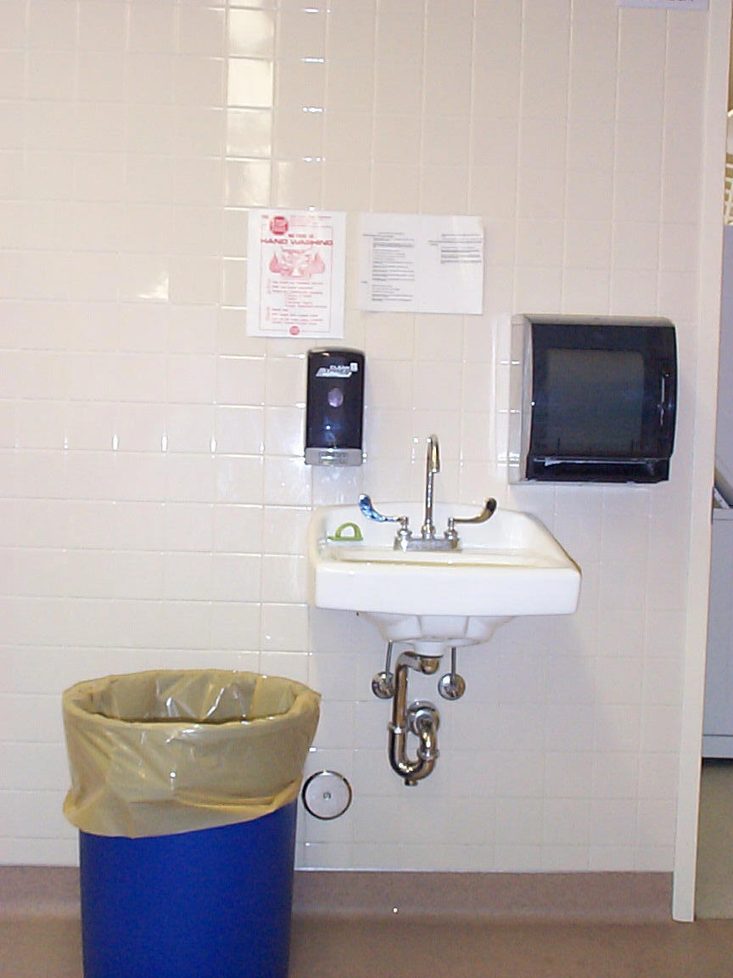
Convenient
Accessible
Properly equipped
Hand Sinks
Are Required
In food prep/dishwash areas
Adjacent to diapering tables
In or adjacent to bathrooms
Paper Towels
Soap
  Hot and Cold Running Water
Waste Container
Notes:
Dispensed paper towels.

Slide 17
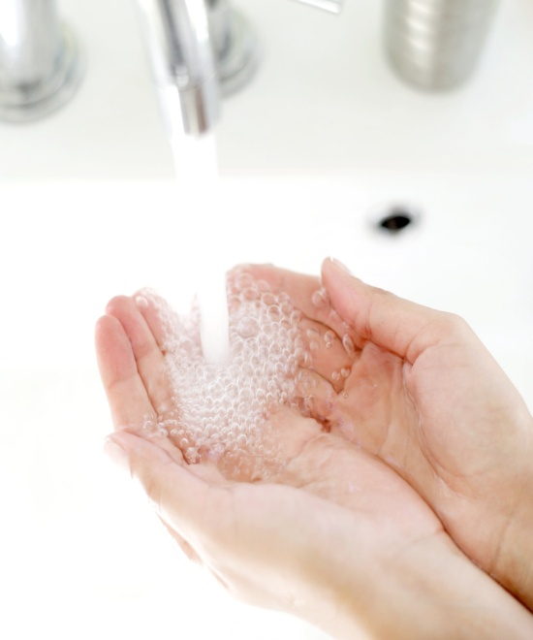
HANDWASHING
WHEN TO WASH HANDS - STAFF
Upon arrival at child care setting.
Immediately before handling food, preparing bottles, or feeding children.
After using the toilet, assisting a child in using the toilet, or changing diapers.
After contacting a child’s body fluids, including wet or soiled diapers, runny noses, saliva, vomit, etc.
After handling pets, pet cages, or pet items.
When changing gloves.
Before giving or applying medication or ointments.
Before handling sensory or water tables.
After cleaning activities.
*Gloves, hand sanitizers and wipes are not a substitute for proper hand washing!

Slide 18


HANDWASHING
WHEN TO WASH HANDS - CHILDREN
Before and after preparing or eating food.
After using the toilet or diapering.
When hands become contaminated with body fluids.
Before and after using sensory tables.
After coming in from outdoors.
After handling pets, pet cages, or pet objects.
Whenever hands are visibly dirty.

Slide 19
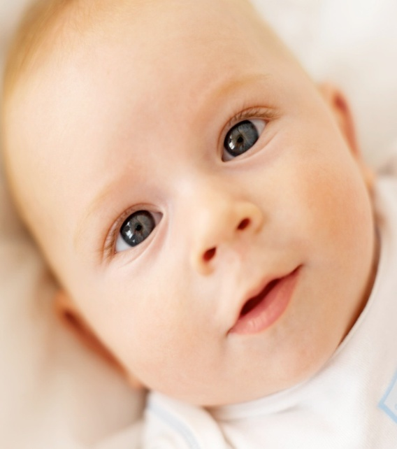
HANDWASHING
When to Wash Hands - Infants
After having their diaper changed.
Before and after meals and snacks.
After coming in from outdoors.
Whenever their hands become soiled through activities.
How to Wash Hands
With soap and running water, or
Individual clean, disposable cloth containing soap, or
Soap & warm water dispensed from spray bottle.
Rinse, or with disposable cloth, then dry.

Slide 20

Demonstration of Knowledge
Staff must be able to demonstrate how they prevent
communicable diseases as it relates to their specific
tasks such as:
When, where, and how to wash hands;
When to prohibit staff from caring for children;
When to prohibit prepping/handling food;
What is the proper diapering procedure;
When and how to properly sanitize and disinfect surfaces and toys.

Slide 21
INFANT/TODDLER NURSERIES
Personal Items
SUPPLIES – Adequate supply of diapers, clothing
and linens for each child.
STORAGE – Each child must have space for
personal items.
WASH CLOTHS & TOWELS – Two wash cloths/One towel
or soft disposable towel
Staff Clothing
Street clothes covered with clean, non-irritating,
washable smock, or similar covering.
a) Must cover lap & shoulders.
b) Change when soiled.

Slide 22
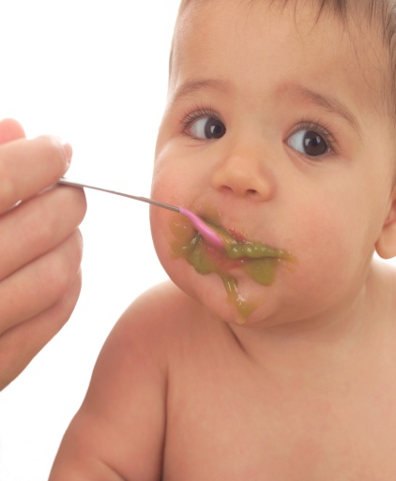
INFANT FEEDING
Staff must wash hands, cover sores, not prepare foods for
other age groups.
Food for infants must be in original container, labeled.
-Container/dish for one child only, discard uneaten portion.
-Open or unconsumed portions refrigerated for the
remainder of the day.
Utensils washed, rinsed, and sanitized after each use.

Slide 23
INFANT FEEDING
FORMULA AND BREAST MILK:
Labeled with infants name and date.
Stored at 41°F or below, discarded if not used that day.
Discard unconsumed portions (frozen breast milk ok).
Formula mixed according to labeling, expired – prohibited.
Bottles shall not be fed over 1 hour period.
Reused bottles washed, rinsed, sanitized.
Bottles never warmed in microwave.
Crock pots used for heating if:
Thawed/warmed for immediate consumption, no re-service.
Warming container emptied, cleaned, sanitized, refilled daily.

Slide 24
DIAPERING
Diapers Shall be Checked:
- At least every 2 hours
- When a child exhibits
behavior suggesting a
soiled or wet diaper
- Changed when found to be
wet or soiled
Changing Station:
- Away from food & food prep
- Easily cleanable
- Hand sink adjacent
- Trash can lined, inaccessible
- Unrelated items not on table
- Cleaned, disinfected after
each use

Slide 25
DIAPERING PROCEDURE
  1. Staff shall put on a new pair of disposable gloves.
  2. Place child on clean, disinfected, dry changing table/mat.
  3. The child shall be cleaned on the body wherever necessary.
  4. Soiled diapers and clothing shall be replaced with clean
  diapers/clothing.
  5. Soiled clothes shall be placed in a plastic bag for parents
  to take home. Soiled diapers shall be placed in a covered, impervious
  plastic lined receptacle.
  6. The infant’s hands shall be washed using soap and warm
  water.
  7. The child may then be returned to a clean crib or to play.
  8. The staff member shall then clean and disinfect the diapering area,
  the equipment/supplies touched during diapering; and the soiled crib or
  cot.
  9. The staff member shall thoroughly wash their hands with soap and
  warm running water and dry their hands with sanitary disposable towels
  or a mechanical drying device.

Slide 26
INTERIOR DESIGN
Personal Belongings A separate identified storage area shall be provided for each child’s personal items, this may be cubicles, drawers, lockers, or coat hooks. Staff’s items must be inaccessible to children.
Napping and Sleeping Supplies Mattresses, mats, or pads must be covered or made of impervious, cleanable materials.
Marked with identifying information unless laundered.
Thoroughly cleaned and sanitized prior to another using it.
Linens cleaned and sanitized 1X per week, or when soiled.
No contact with other sleeping surfaces.
4. Clean linens not stored in restrooms.

Slide 27

INTERIOR DESIGN
Ill/Injured Child Area - All facilities must include a
designated area for any injured or ill child.
Area must be ventilated and heated.
A bed, cot, or mat with a sheet and blanket.
Must have access to toilet and lavatory without interruption
by other children and staff.
Staff supervision of child at all times.
Toys, Furnishings & Equipment - Must be
maintained clean and in good repair.
Infants & Toddlers must have items that are easily cleanable.
In-use toys laundered at least 1x/week
Toys removed for sanitizing/laundering when mouthed or
visibly soiled.
d. High hazard body fluids will be immediately cleaned & disinfected.

Slide 28
SANITIZING vs DISINFECTING
What is the Difference?
Why does it Matter?
  SANITIZERS
  Have the capacity to reduce the
  number of microorganisms to a
  safe level.
  Used on: Kitchen surface
  Sleeping mats, Drinking
  fountains, Table tops, Toys,
  Infant food prep areas.
  DISINFECTANTS
  Have the capacity to destroy
  microorganisms. Must have a
  higher kill capability for
  pathogenic bacteria.
  Used on: Diaper changing
  tables, Toilets, Hand sinks used
  for diapering, Restroom
  surfaces.
ALL SANITIZERS AND DISINFECTANTS MUST BE REGISTERED WITH EPA (21 CFR 178.1010 www.cfsan.fda.gov)
In Colorado visit: www.ag.state.co.us/dp/pesticides/PPRS/PPRSQuery.htm

Slide 29
SANITIZING VS DISINFECTING
Bleach (Sanitizer)
5.25% (Household Bleach)
1 Tblsp per gallon of water
6.00% (Ultra Bleach)
2.5 Tsp per gallon of water
Results in: 50 – 200 ppm
Contact time: 1 minute
Clearly Label Container
Bleach (Disinfectant)
5.25% (Household Bleach)
¼ C. per gallon of water
6.00% (Ultra Bleach)
3.5 Tblsp per gallon
Results in: Approx 1000 ppm
Contact time: 1 minute
*CDC recommends 2 minutes
Clearly Label Container
Use Chlorine Test Kit to Verify Correct Sanitizer Concentration
Specialized Test Kits Available for Verifying Disinfection Level

Slide 30
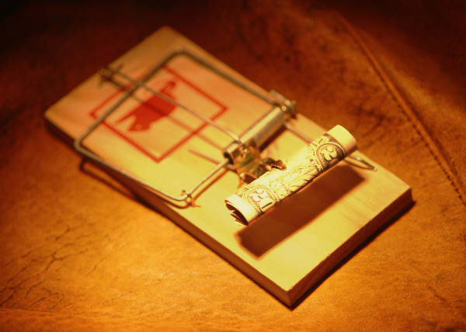
TOXIC MATERIAL MANAGEMENT
INSECT & RODENT CONTROL
Use pesticides as a last resort.
Follow label instructions, apply only when children are not present.
Do not contaminate surfaces contacted by food and/or children.
Only U.S. EPA registered insecticides, rodenticides, and herbicides may be used.
Rodenticides in tamper proof box, cake or pellet form.
Restricted pesticides applied only by certified pest control operator

Slide 31

TOXIC MATERIAL MANAGEMENT
INSECT & RODENT CONTROL
Limit materials to those necessary for maintenance & up keep
of facility.
Labeled for easy identification.
3) Stored to prevent contamination of food or surfaces touched by children.
4) Stored inaccessible to children.
ASBESTOS – Before renovation/demolition, inspection required by certified asbestos inspector. Does not apply to buildings constructed after 10/12/1988.
LEAD PAINT- U.S. EPA Regulation (4/22/10) requires training for firms that renovate, repair or paint projects which disturb paint in pre-1979 housing and child-occupied facilities.

Slide 32

What To Do When Illness Occurs In The Child Care Facility
The facility shall manage and control disease transmission by communication with their NURSE CONSULTANT. Communicable diseases shall be reported to the Department.
Implementing currently recognized guidelines such as Infectious Disease in Child Care Settings, Guidelines for Child Care Providers.
If the child is ill upon arrival he or she shall not be admitted.
Separating a sick child from other children until a parent or guardian can pick up the child.
Child care staff shall wash hands and put on gloves if in contact with blood, feces and other high hazard body fluids.

Slide 33


GENERAL FACILITY
Outdoors:
Grounds free of weeds, pest harborage, stagnant waters, unused equipment, garbage areas – well maintained.
Use of wading pools by infants and toddlers not toilet trained
is prohibited.
When used, they must be kept clean and disinfected, maintain
a 0.4 to 2.0 ppm chlorine residual or equivalent, and stay
between 77°F and 90°F.
Detached Structures/Modular Classrooms – If no plumbing, shall only care for school age, restrooms
within 200 ft of structure.

Slide 34
GENERAL FACILITY
Indoors:
Building in good repair with safe, cleanable
finishes; carpeting – not permitted in restrooms, kitchens, around sinks, diaper changing areas, or laundry.
Adequate lighting, heating 68ºF at floor level.
Care of Animals:
3 adult animals per 25 children at a facility.
Prohibited animals – Psittacine birds, ferrets, primates, poisonous/aggressive fish and amphibians, wild caught animals. Children under 5 – no reptiles/amphibians.
Enclosures kept clean, children supervised, fly & mosquitoes controlled.
Animal feed separate from human food.

Slide 35
GENERAL FACILITY
Plumbing
Water – Safe source (wells tested 1x per quarter)
Drinking water:
1. Accessible at all times.
2. Fountains with angled jets/orifice guards,
appropriate height.
3. No fountains on art or science sinks.
4. Thermos jugs cleaned daily.
Hot Water:
1. Available at all times. (90ºF – 120ºF accessible to
children)
2. Hot water heater 90ºF to restrooms, diaper changing,
classroom sinks and 140ºF to kitchen, laundry, custodial .

Slide 36
GENERAL FACILITY
Toilet Facilities – Fixtures appropriate height, platform.
Hand Washing/Bathing Facilities
Appropriate height.
Must be in/immediately adjacent to toilet rooms/diapering
food preparation.
*New/remodeled, care to infants, toddlers, preschoolers,
shall provide hand washing sink visible/no barriers.
Soap/paper towels from dispensers.
Laundry Facilities
Inaccessible to children.
Vented.
Soiled linens in nonabsorbent bags, separated from clean, food
prep/storage, restroom.
Water temperature 140ºF, or disinfectant, or dryer 140ºF.

Slide 37
SOURCES OF INFORMATION
RULES AND REGULATIONS GOVERNING THE SANITATION OF CHILD CARE CENTERS IN THE STATE OF COLORADO, Effective May 30, 2005, http://www.cdphe.state.co.us/regs/101007.pdf
THE ABC’S OF SAFE AND HEALTHY CHILD CARE, CENTERS FOR DISEASE CONTROL, http://www.cdc.gov/ncidod/hip/abc/intro.htm
COLORADO RETAIL FOOD ESTABLISHMENT RULES AND REGULATIONS, http://www.cdphe.state.co.us/regulations/consumer/101002RetailFood.pdf

